Slide 1
Layouts in flutter
Module: UI Design, Lecture: 2

Slide 2
Remembering Widgets

Slide 3
Widgets
We know that everything we see in our UI is a widget.
There are two types of widgets -
Stateless widgets: Perfect when the widget does not need to update parts of it. Stateless widgets are there to simple display information. If the widget is to be updated, it must be rebuilt.
Stateful widgets: Perfect when the widget may need to update parts of it. In such cases, it will rebuild just the relevant parts to update it.

Slide 4
Widgets
We will take a deep dive into stateless and stateful widgets later down the course. For now, let us stick to stateless ones.
To create one, just type “stless” and hit enter for autocomplete to do the rest. Type a name for the widget and hit enter.

Slide 5
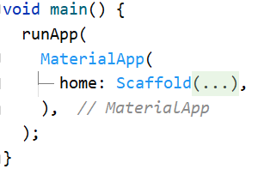
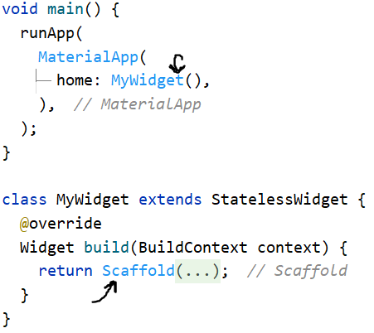
Widgets
So now our code goes from this: To this:

Slide 6
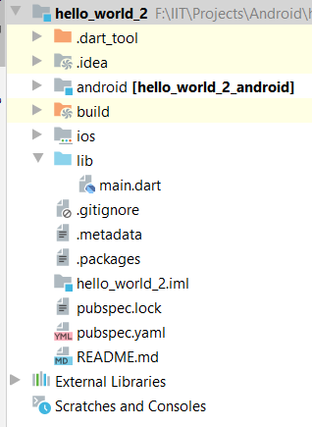
Widget
In fact, we should not keep the main.dart file cluttered. Let’s move our new widget to a new file.
Right click on lib folder and create a new dart file. Cut and paste the widget there.
Hit alt+enter on the errors and import the necessary items.

Slide 7
Hot reload and hot restart
Hot restart rebuilds the entire app. It takes around 10 seconds at max. We use this for major changes or for stateful widgets
Hot reload implements the changes in UI almost instantaneously. We use this very commonly, mostly for minor changes.

Slide 8
Building complex layouts

Slide 9
Layouts in Flutter
Complex widgets in flutter are build by multiple simple widgets.
Hence, it would be a good idea to know how to lay them out as we please.
So how do we layout widgets in flutter? Using more widgets!
The centre widget is a layout widget for example. It helps us lay another widget at the center.
There are other layout widgets too. Let’s take a look.

Slide 10
Vertically and horizontally layouts
You can use a Row widget to arrange widgets horizontally, and a Column widget to arrange widgets vertically.
Row and Column are two of the most commonly used layout patterns.
Row and Column each take a list of child widgets.
A child widget can itself be a Row, Column, or other complex widget.

Slide 11
Vertically and horizontally layouts
You can specify how a Row or Column aligns its children, both vertically and horizontally.
You can stretch or constrain specific child widgets.
You can specify how child widgets use the Row’s or Column’s available space.
Let’s have a look at how important they are

Slide 12
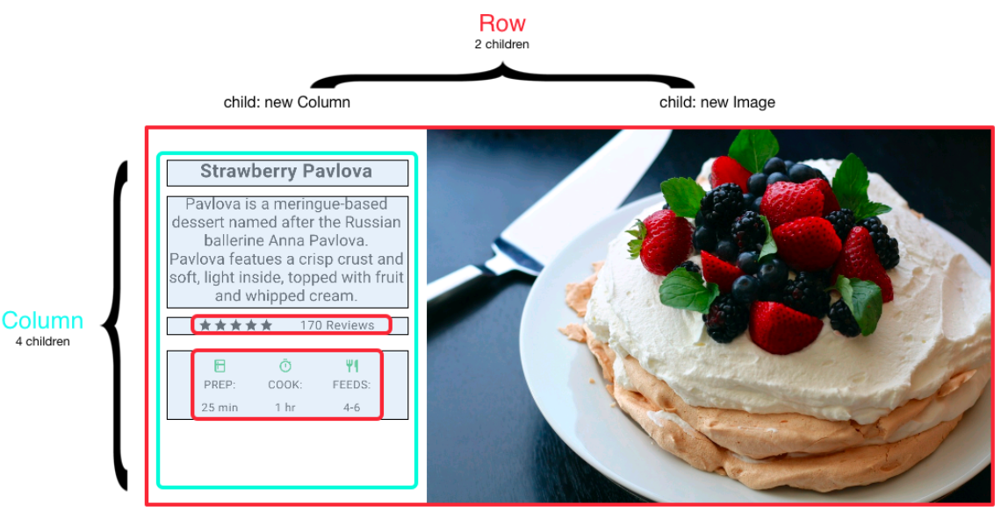
Vertically and horizontally layouts

Slide 13
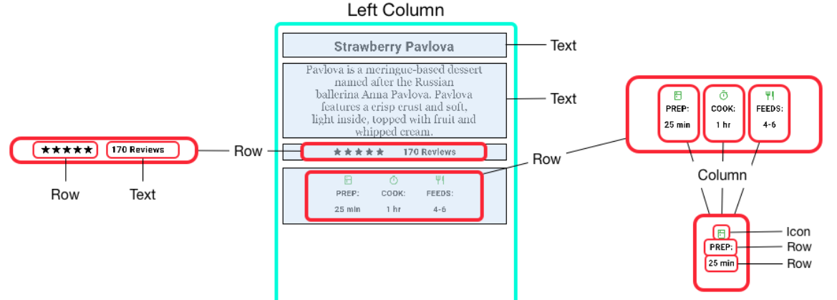
Vertically and horizontally layouts

Slide 14
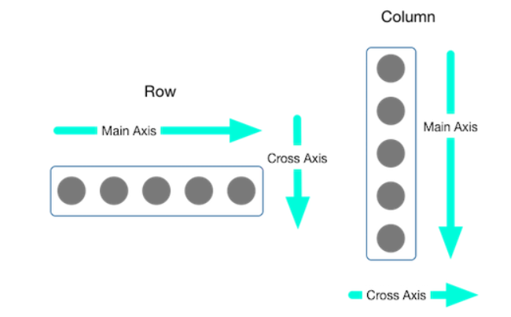
Aligning widgets

Slide 15
Main axis alignment
The enum MainAxisAlignment has the following properties -
start : Place the children from the starting of the row/column.
end : Place the children at the end of the row/column.
center : Place the children at the center of the row/column.
spaceBetween : Place the space evenly between the children.

Slide 16
Main axis alignment
The enum MainAxisAlignment has the following properties -
spaceAround : Place the space evenly between the children and also half of that space before and after the first and last child.
spaceEvenly : Place the space evenly between the children and also before and after the first and last child.

Slide 17
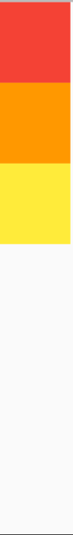

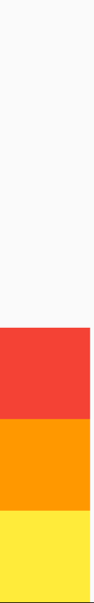
Main axis alignment (column example)
start center end

Slide 18
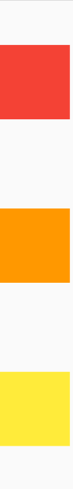
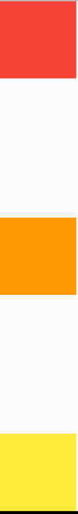
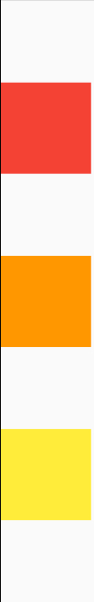
Main axis alignment (column example)
spaceAround spaceBetween spaceEvenly

Slide 19
Main axis size
A property of column and row is mainAxisSize.
By default, the main axis size is set to mainAxisSize.max. It occupies the maximum space in the main axis and the minimum space in the cross axis.
Challenge: Now repeat the mainAxisAlignment values with mainAxisSize set to min. Can you explain the differences?

Slide 20
Cross axis alignment
Like for the main axis, we have some options for crossAxisAlignment
start : Place the children from the starting of the row/column.
end : Place the children at the end of the row/column.
stretch: Stretch the children along the cross axis to fill the available space.

Slide 21
Challenge
Challenge: Fill a row/column with containers of equal width and height. Test by alternative values of cross axis alignment from start, center, end.
Can you explain the results?
What change can you bring to make the results noticeable?

Slide 22
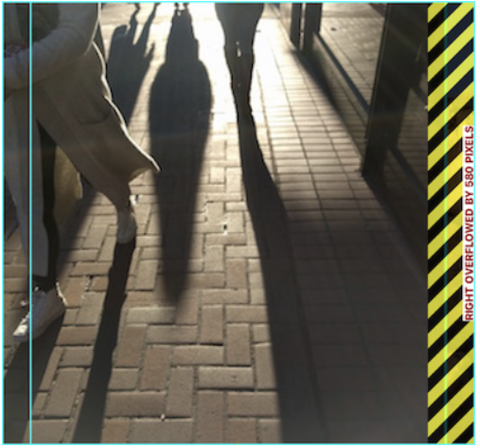
Sizing widgets
When a layout is too large to fit a device, a yellow and black striped pattern appears along the affected edge. Here is an example of a row that is too wide:

Slide 23
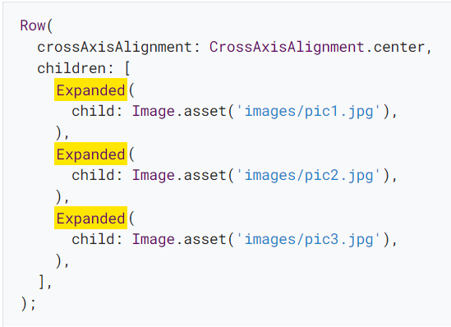
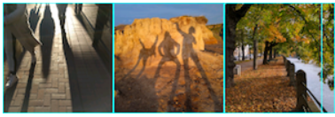
Fitting widgets
Widgets can be forced to fit the main axis (either by shrinking or expanding) within a row or column using Expanded widget.

Slide 24
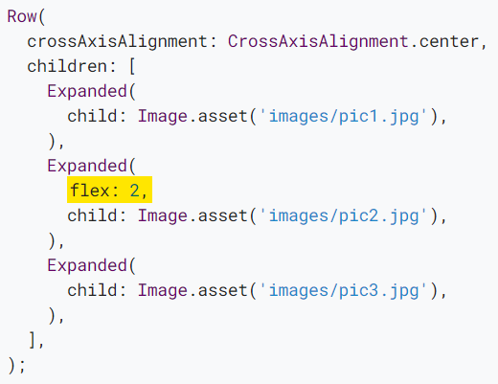
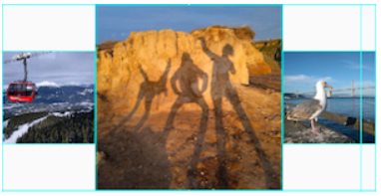
Fitting and sizing widgets
Perhaps you want a widget to occupy twice as much space as its siblings. For this, use the flex property, an integer that determines the flex factor for a widget

Slide 25
Boss level Challenge!

Slide 26
Can you implement this UI?

Slide 27
Challenge
You can use images, colors, icons, text, etc., of your choice
You don’t necessarily have to place the image on the right of the “details” section. You can place it on top if you like.
In other words, you don’t have to make a xerox copy of this design. Feel free to play along and come up with something unique.
Bordering the containers is optional. But why not search a way to do that from flutter documentations?
Speaking of documentations, you may like searching for “padding” there too (more on this later)

Slide 28
Thank you

